Slide 1
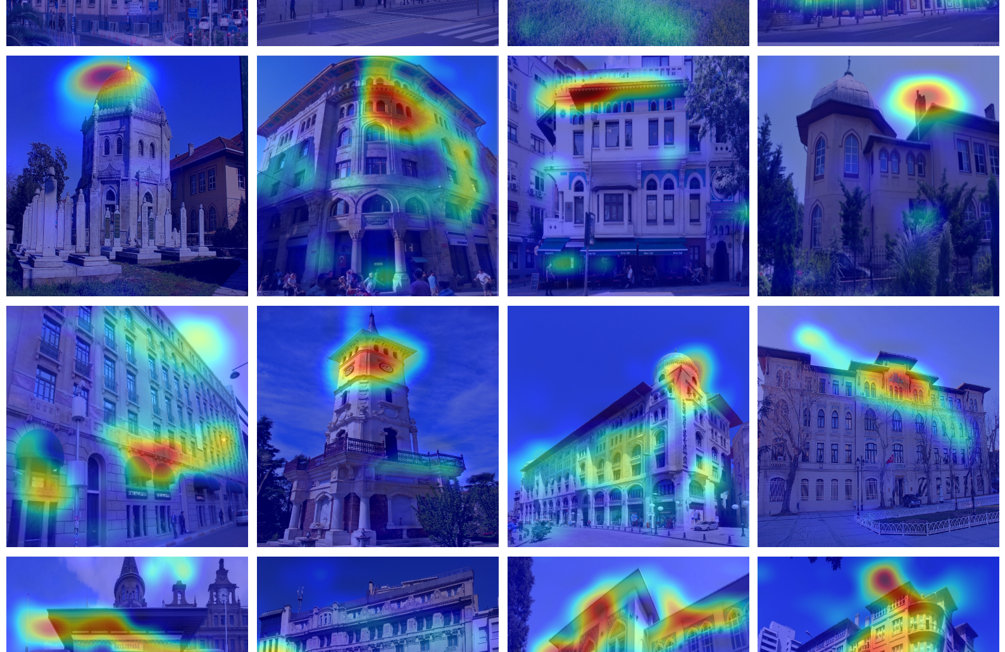
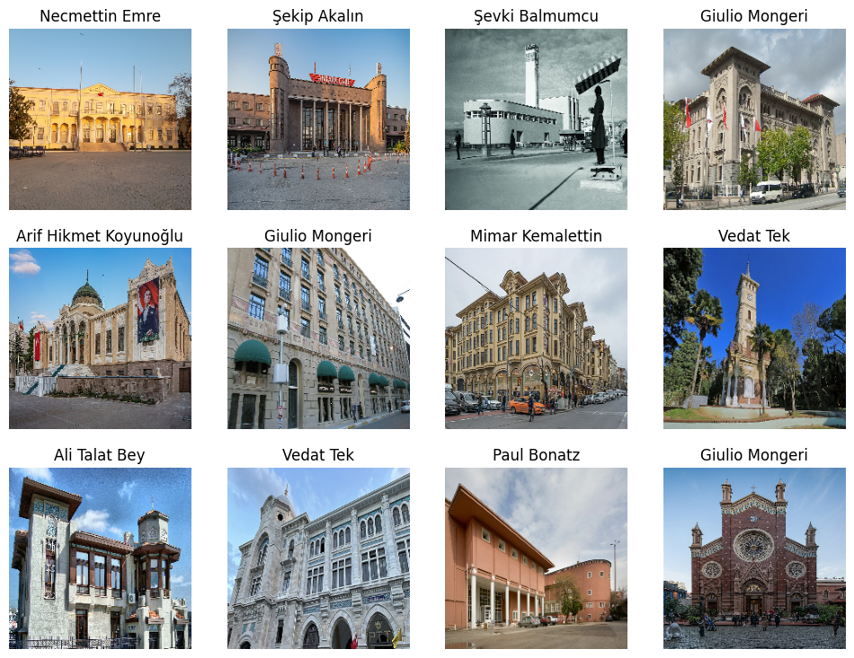
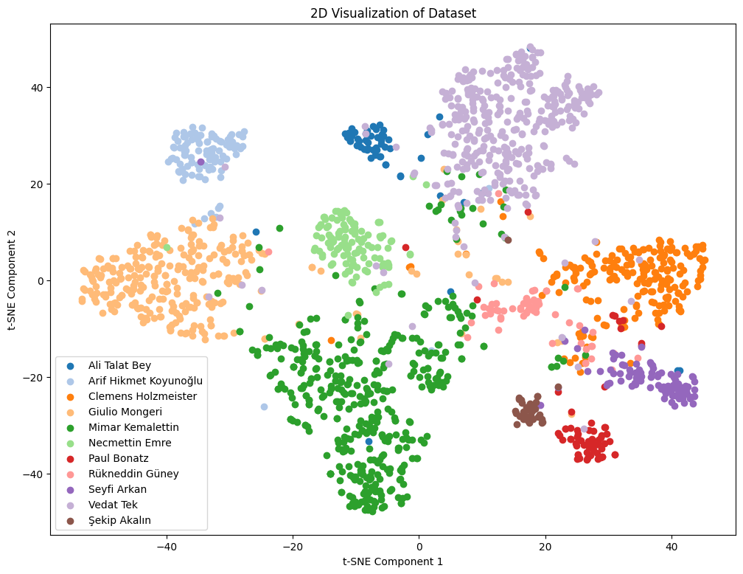
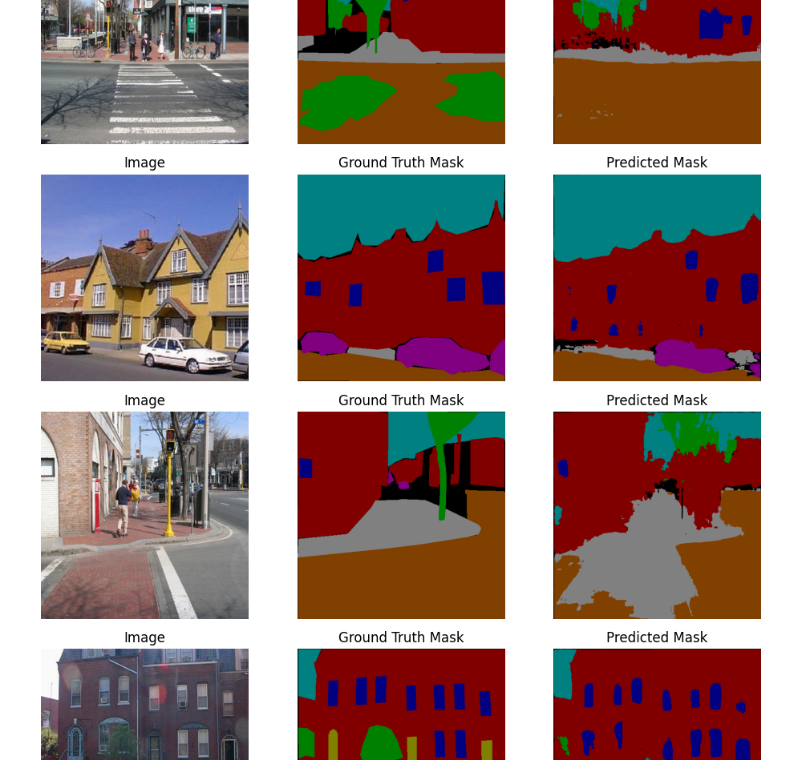
Architectural Style Classification using Semantic Segmentation
Emirkan Burak YILMAZ, Yusuf Sinan AKGÜL, Funda TAN

